Slide 1
Sign Language Hand Gesture Recognition using Machine Learning
Done by –
Raghul.P.V (211417104207)
Rajesh Kumaran.A(211417104214)
Ranjith.T (211417104222)
Guide by-
Mr. Jainulabudeen.S.A.K
Coordinator by-
Dr.N.Pughazendi

Slide 2
ABSTRACT
Gesture recognition is an emerging topic in today’s technologies. The main focus of this is to recognize the human gestures using mathematical algorithms for human computer interaction.
Gesture recognition is one of the essential techniques to build user-friendly interfaces.
Usually gestures can be originated from any bodily motion or state, but commonly originate from the face or hand. Gesture recognition enables users to recogonize the action and giving out the command of the action.
This project describes how hand gestures are trained to perform actions to detect the signs by the user and reflecting the output by the system.

Slide 3
LITERATURE SURVEY
Hand Gesture Recognition for Human Computer Interaction, International Conference on Image Information Processing India
Hand Gesture Recognition Systems: A Survey, International Journal of Computer Applications Volume 71– No.15, May 2013.
Comparative Study of Hand Gesture Recognition Algorithms, International Journal of Research in Computer and Communication Technology, Volume3, Issue 4, April- 2014.

Slide 4
PROBLEM STATEMENT
In this project, with the help of CNN, we are going to calculate the command that we are inputting to the system by sign gestures and the gestures will reflect.
The probable command which the user is trying to reflect is shown in the output bar.
With the sign language user is showing, the computer recognizes the input and the command which the user is intended is shown as an output.
This can help to interact people as a medium who are want to communicate with people who are communicating with people who knew the gestures of American Sign Language and the people who aren’t with the help of our Web UI.

Slide 5
Technology Stack
The requirements for hand detection involve the input image from the webcam. The image should be fetched with a speed of 20 frames per second. Distance should also be maintained between the hand and the camera.
Approximate distance that should be between hand the camera is around 30 to 100 cm. The video input is stored frame by frame into a matrix after preprocessing.
This step involves: Gesture Recognition: The number of fingers present in the hand gesture is determined by making use of defect points present in the gesture. The resultant gesture obtained is fed through a 3Dimensional Convolutional Neural Network consecutively to recognize the current gesture.

Slide 6
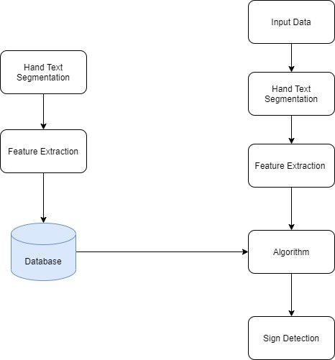
System Architecture

Slide 7
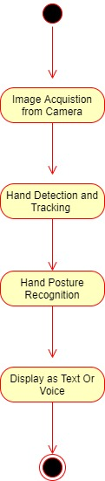
System Architecture

Slide 8
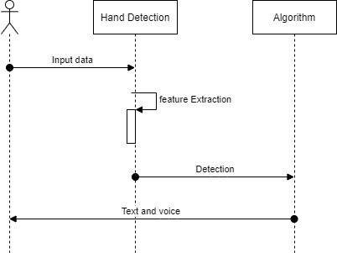
SEQUENTIAL DIAGRAM

Slide 9
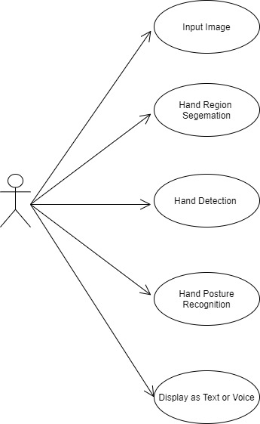
USE CASE DIAGRAM

Slide 10
SYSTEM MODULE
Capture scene: Captures the images through a web camera, which is used as an input to the system that is built.
Preprocessing: Images that are captured through the webcam are compared with the dataset.
It helps to recognize the valid hand movements that are needed to perform the required actions.

Slide 11
HAND DETECTION
The requirements for hand detection involve the input image from the webcam.
The image should be fetched with a speed of 20 frames per second. Distance should also be maintained between the hand and the camera.
Approximate distance that should be between hand the camera is around 30 to 100 cm.
The video input is stored frame by frame into a matrix after preprocessing.

Slide 12
GESTURE RECOGNITION: CNN
Gesture Recognition: The number of fingers present in the hand gesture is determined by making use of defect points present in the gesture.
The resultant gesture obtained is fed through a 3Dimensional Convolutional Neural Network consecutively to recognize the current gesture.
Performing action: The recognized gesture is used as an input to perform the actions required by the user. Then the intended result is shown.

Slide 13
WORKING
Detection of Hand: This module detects the hand gesture by capturing an image through the web camera.
Finger Tip Detection and Defect Calculation: A boundary box is drawn around the hand for which the finger tips are detected and the background space around iis eliminated.

Slide 14
With the implantation of TensorFlow Framework and Keras model for deep learning and training the model, gesture recognition accuracy has inevitably increased.
As a new image get inputted into the system, it is compared with the already trained model and processed thereafter.
Once gesture data are processed, matched and evaluated, if the gesture is recognized.

Slide 15
IMPLEMENTATION
1. Detection of Hand: This module detects the hand gesture by capturing an image through the web camera.
2. Finger Tip Detection and Defect Calculation: A boundary box is drawn around the hand for which the finger tips are detected and the background space around it is eliminated.
3. Gesture Recognition: The image is compared with the dataset in order to recognize it and perform the actions required.

Slide 16
Gesture data are processed, matched and evaluated, then the gestures are recognized.
Then it is properly classified by the model, it carries out the respective operation by issuing back response to the gesture system.
We used the hand gesture recognition database that Kaggle provided for our project.
It includes 200 pictures of different hands and hand gestures.
The data collection includes a minimum of 10 hand movements involving 10 separate individuals.

Slide 17
We have designed an Web UI to interact with the software.
The Webcam identifies our action and it will convert the gestures and it will show what intended output is shown with accuracy.
With the help of gestures, we can understand what command the user is trying to show.

Slide 18
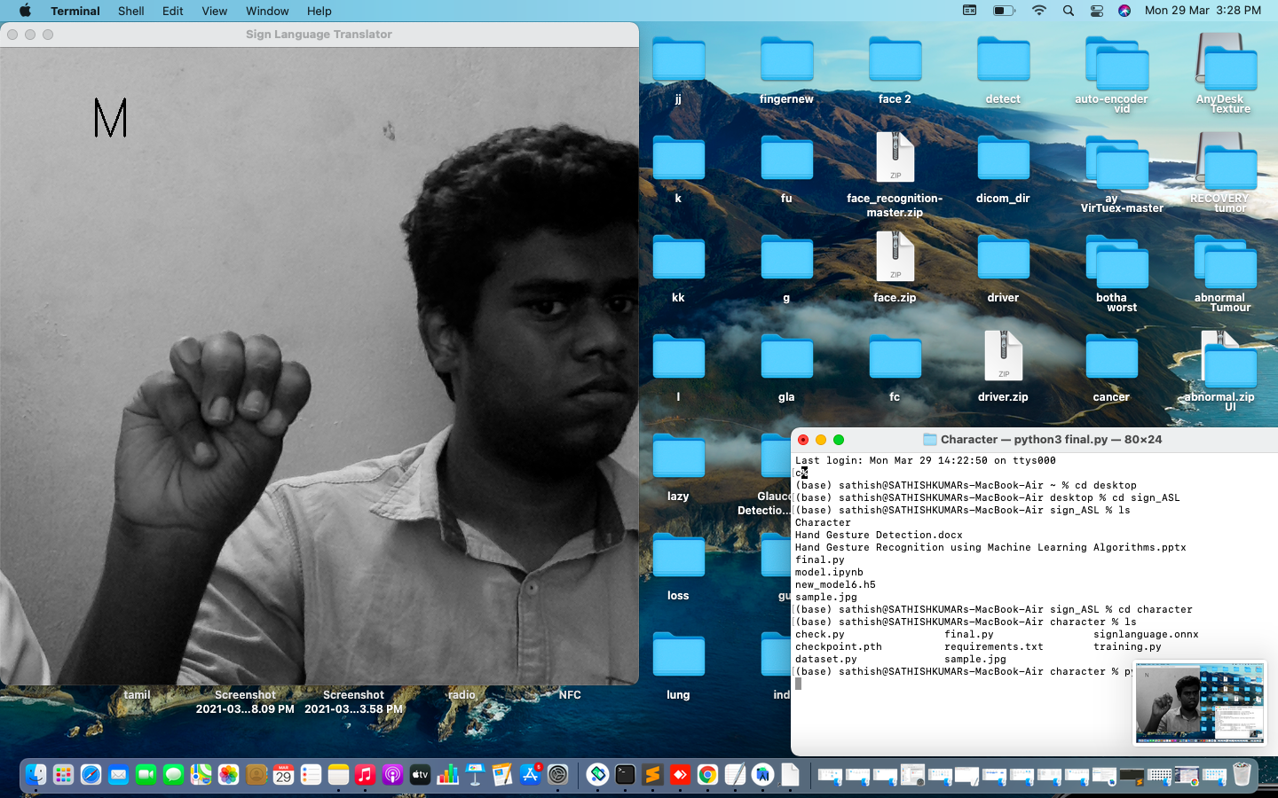
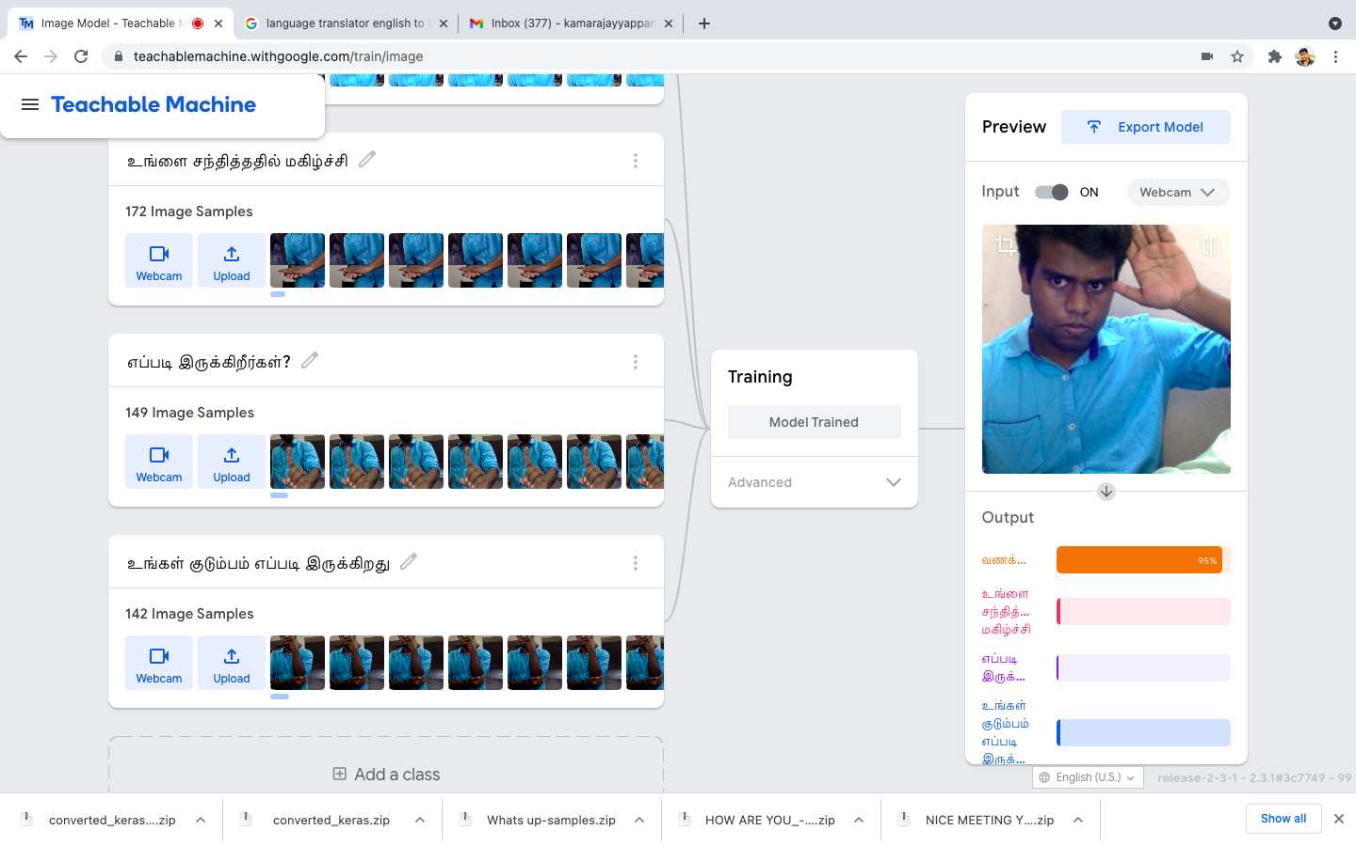
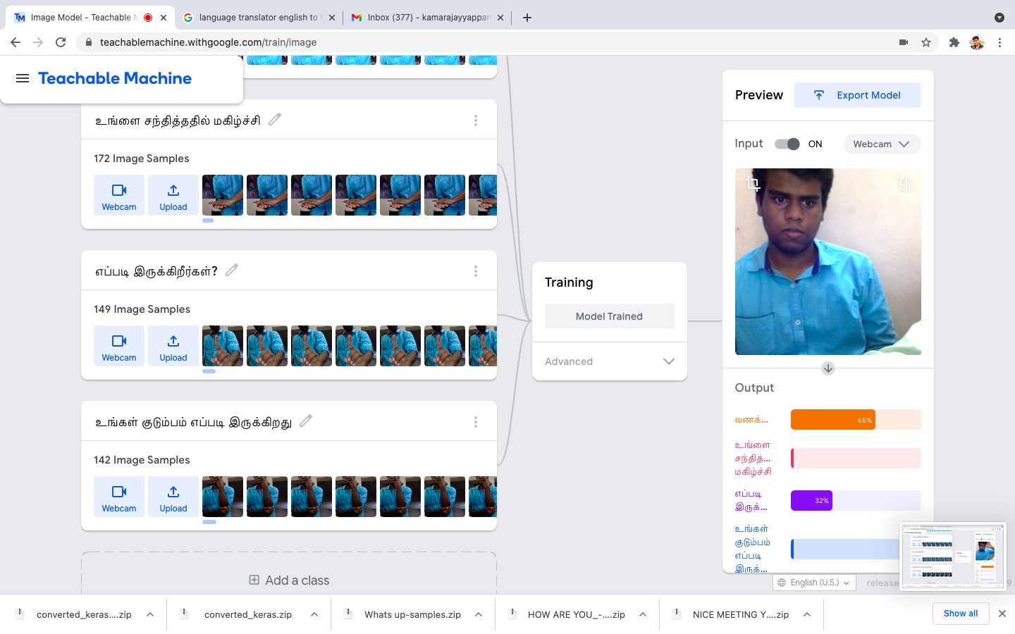
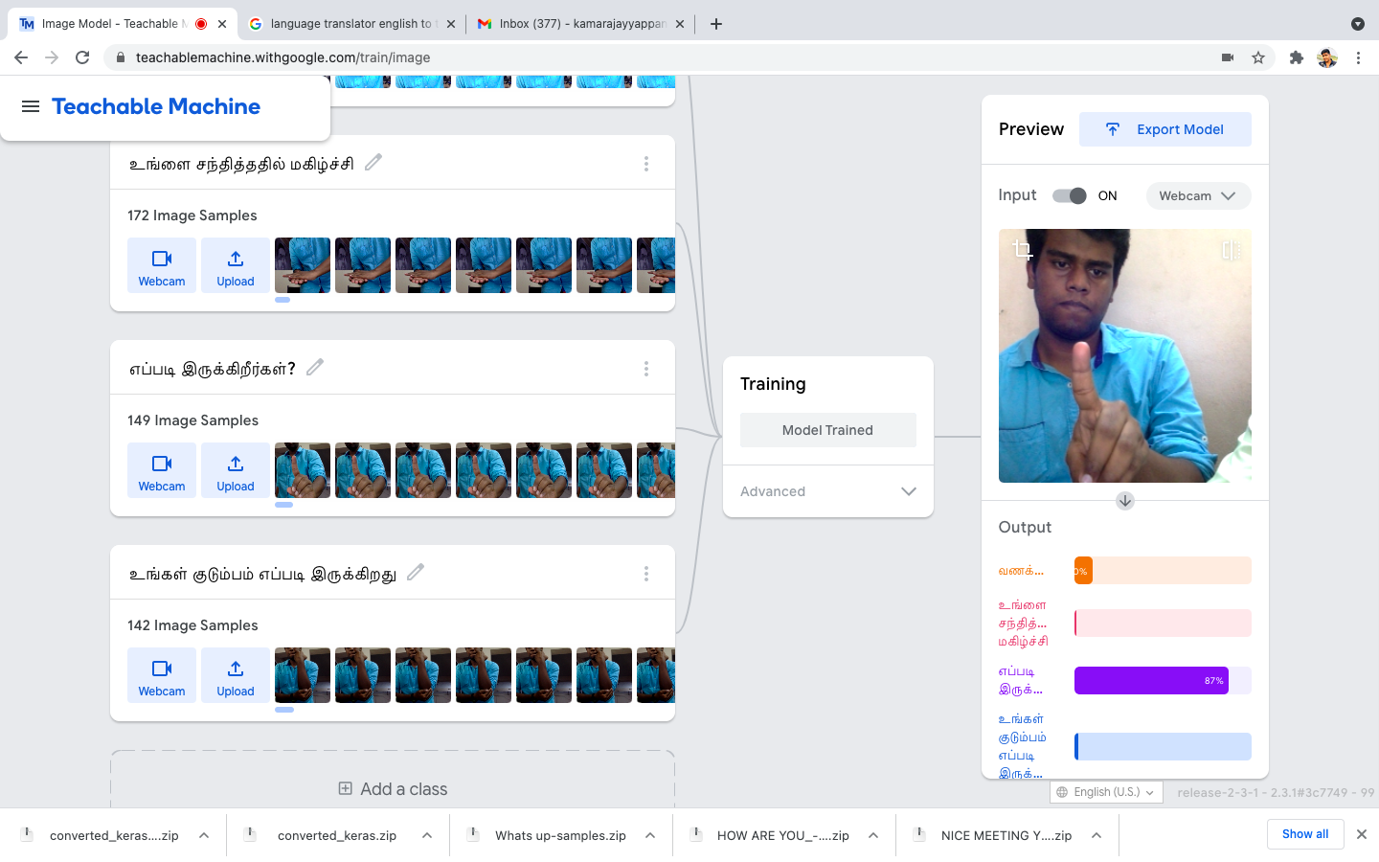
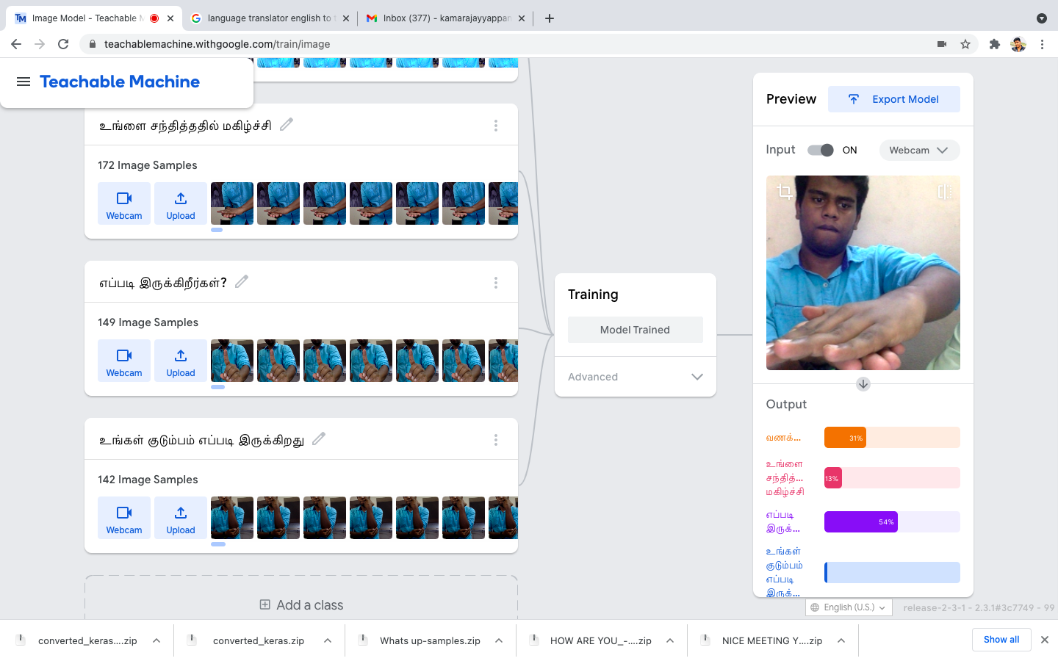
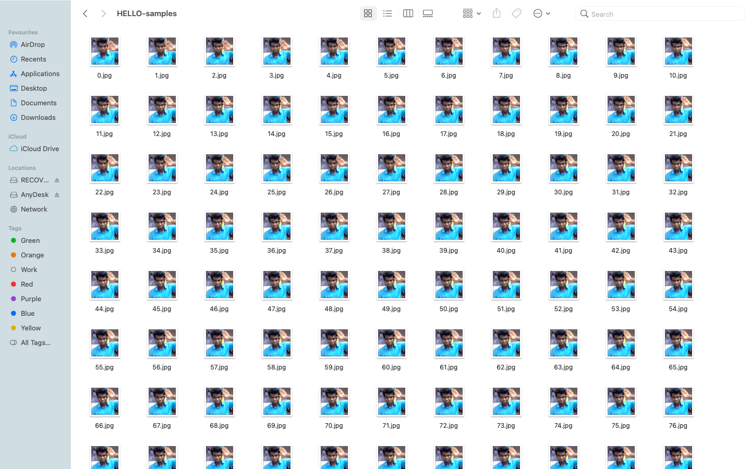
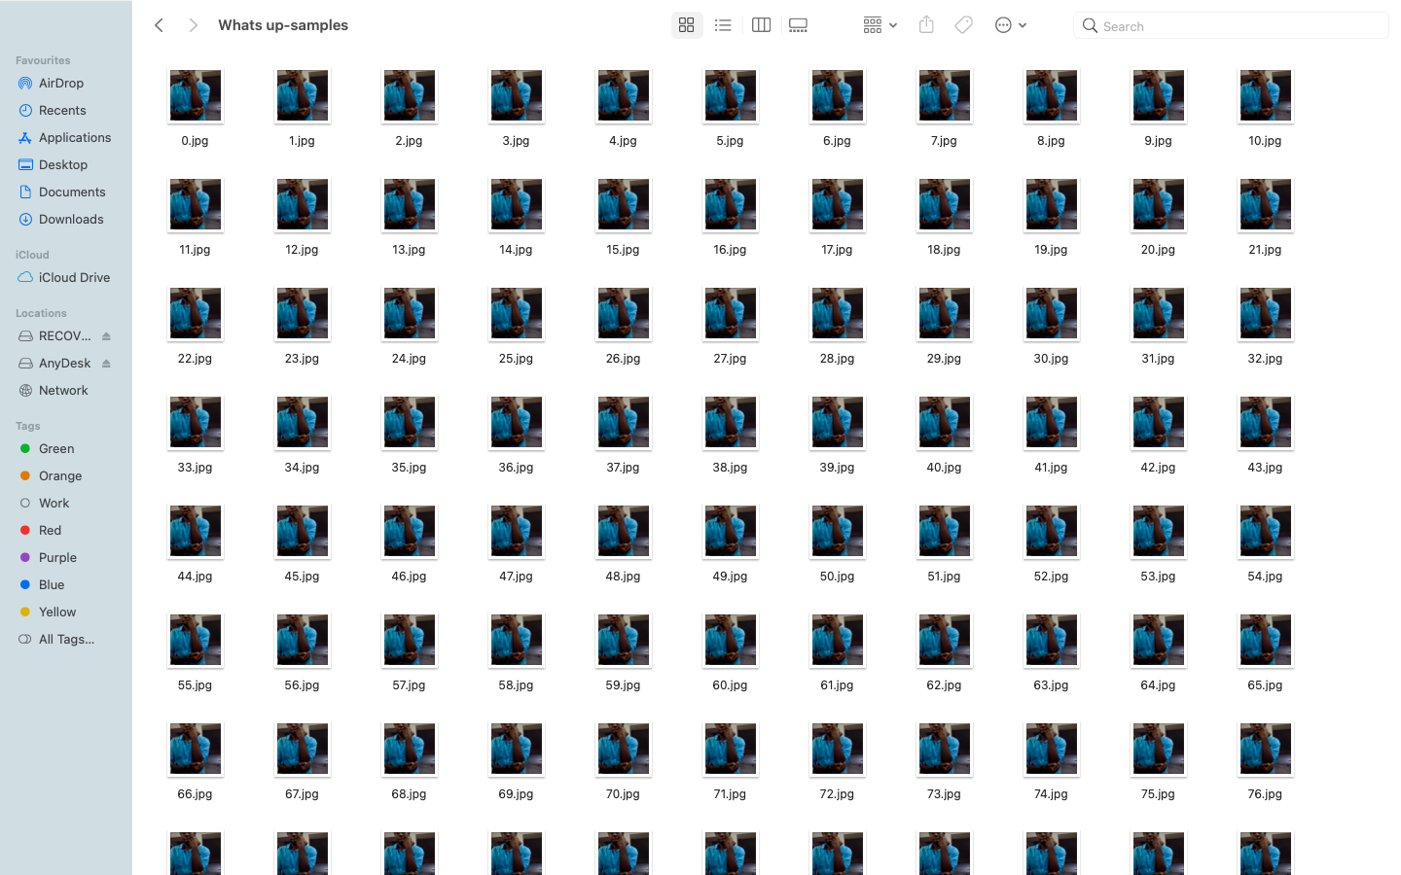

Slide 21
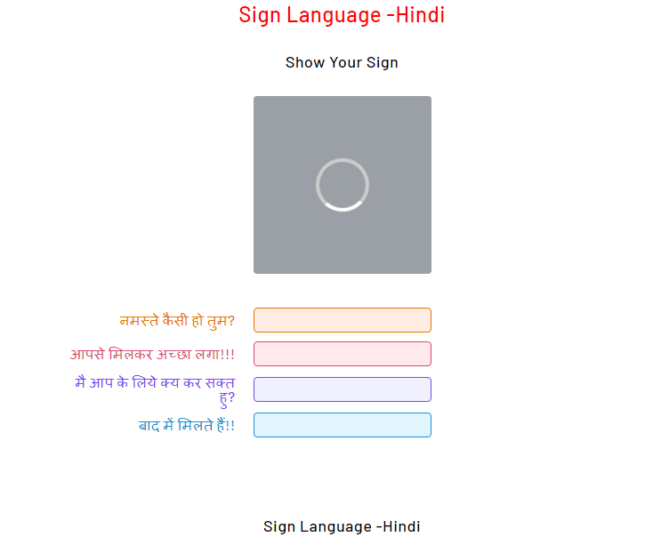

Slide 22
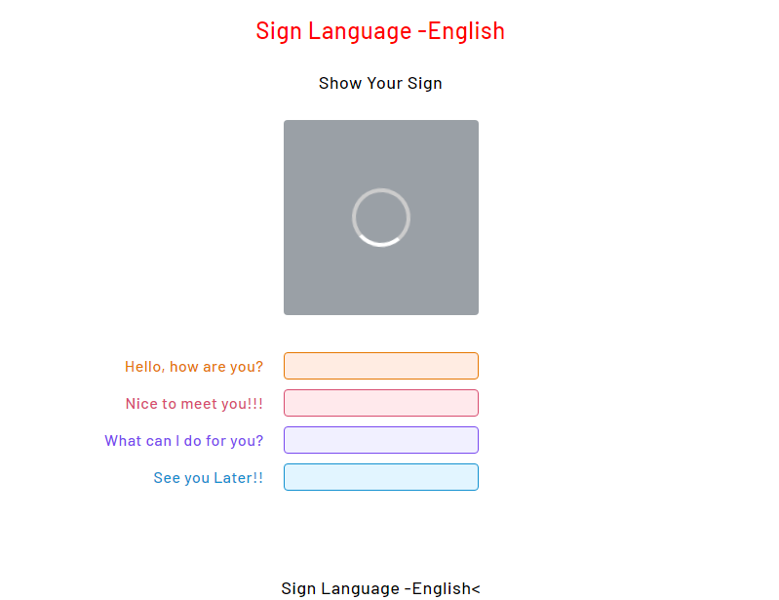

Slide 23
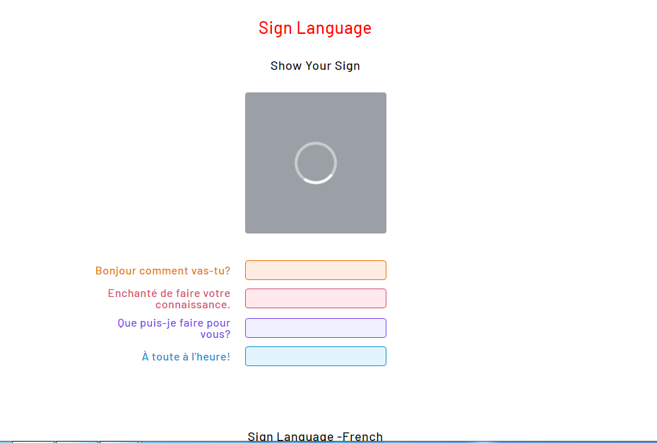

Slide 24
Conclusion
The results also showed that the gesture recognition application was quite robust for static images.
However, the video version was enormously affected by the amount of illumination, such that is was necessary to check and adjust the HSV values for skin colour when starting the program to get the proper output.
Sometimes the adjustment was difficult to do because of the lighting conditions and the amount of objects in the background.
The application was very susceptible to noise on the video stream. Slight hand movements could affect gesture recognition.
Nevertheless, if the hand is steady enough for long enough; the program outputs the correct command.

Slide 25
REFERENCES
1. Meenakshi Panwar, Pawan Singh Mehra, Hand Gesture Recognition for Human Computer Interaction, International Conference on Image Information Processing India (2011).
2. Rafiqul Zaman Khan and Noor Adnan Ibraheem, Comparitive Study of Hand Gesture Recognition System, AIRCC Digital Library – 2012.
3. Arpita Ray Sarkar, G. Sanyal, S. Majumder, Hand Gesture Recognition Systems: A Survey, International Journal of Computer Applications Volume 71– No.15, May 2013.
4. Manjunath A E, Vijaya Kumar B P, Rajesh H, Comparative Study of Hand Gesture Recognition Algorithms, International Journal of Research in Computer and Communication Technology, Vol 3, Issue 4, April- 2014.
5. Dnyanada R Jadhav, L. M. R. J Lobo, Navigation of PowerPoint Using Hand Gestures, International Journal of Science and Research (IJSR) 2015. 6. Ruchi Manish Gurav, Premanand K. Kadbe, Real time finger tracking and contour detection for gesture recognition using OpenCV, IEEE Conference May 2015, Pune India.
7. Pei Xu, Department of Electrical and Computer Engineering, University of Minnesota, A Real-time Hand Gesture Recognition and Human-Computer Interaction System, Research Paper April 2017.
8. P.Suganya, R.Sathya, K.Vijayalakshmi , Detection and Recognition of Gestures To Control The System Applications by Neural Networks, International Journal of Pure and Applied Mathematics 2018.

